Slide 1


Welcome to all

Slide 2
GLA UNIVERSITY
DEPARTMENT OF COMPUTER SCIENCE
MINI PROJECT II
ON
TOUR IN INDIA
By
Ved Prakash Chaubey ,Nikhil Mishra,Rajan Sharma
Under the guidance of
Md.Farman Sir

Slide 3
PURPOSE
The purpose of this mini - site is to develop a valuable set of information source that provides tourism with information and news about places and situation about the weather ,climate , rule of government which should have to follow by the tourism .
This website will also serve as a local as well as for foreigners and give social environment that allows for tourism to discuss and chat about the place related topics.

Slide 4
Tour In India
OBJECTIVE : India is a diverse country. India has a wide variety of culture, climate, religions and tourist spots. Therefore India is a tourist hotspot.Our objective is to provide true and essential information to the tourist so they can not misplaced their destination and enjoy their vacations and holiday .
And we want the spread the all cultures and religions in society so people can also visit in Temple,Mosque,gurdwara,church.

Slide 5
METHODOLOGY
The elaboration of Web pages includes
the phases of Analysis.
Planning : For planning we use Backlog
Content.
Design :For designing we use traditional or also scrum approach.
Programming : We use pair programming.
Testing.

Slide 6
How it help the Tourist
It will secure the life.
It will show the right path to the touristers.
Reduce the treacherous.

Slide 7
The number of FTAs in India during:
• 2010: 5.78 million
………...
• 2018: 10.29 million
• 2019: 10.86 million
The number of foreign tourist arrivals in the country in 2020 showed an increase of about 4.1 % over 2010.

Slide 8
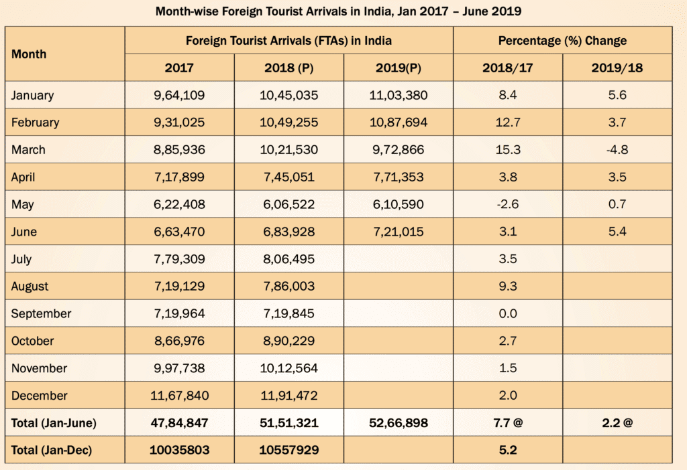
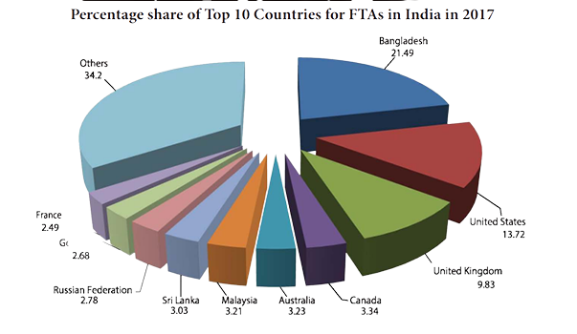
Graph

Slide 9
Hardware and Software to be used
SOFTWARE
We use HTML (hypertext markup language), CSS (cascading style sheet), PHP (hypertext pre-processor),java script, vs code and sublime text. (source code editor),Github
HARDWARE
HP,Mac book,Lenovo with 4GB RAM
Hard Disk Drive (500 GB SATA 5400 RPM OR Higher)
Latest Generation 64 bit multicore X86 Intel Pentium or equivalent AMD processor

Slide 10
ADVANTAGE
Direct benefits include economic support for hotels, retail shops, transportation services, entertainment venues and attractions, while indirect benefits include government spending on related infrastructure, plus the domestic spending of Indians employed in the tourism sector.When a lively tourism industry induces the government to invest in national parks and preserves, the environment may benefit.

Slide 11
DISADVANTAGE
Loss of Potential Economic Benefits .
Economic and Employment Distortions .
Inflation and Loss of Amenities for Residents .
Fluctuations in Productivity Index .
Water Pollution .
Air Pollution .
Noise Pollution .
Visual Pollution .

Slide 12
Explore India from Kashmir to Kaniyakumari
ALL
NORTH
CENTRAL
NORTH-EASTERN
SOUTH

Slide 13
SCOPE FOR EXTENSION INTO A MAJOR PROJECT
Extension in major project we will add the hotels ,hospitals, travel and toursit agency . We will attach Hotels with all type like for all class of family so they can not make any misunderstanding about the place is costly or cheap. When he reach their favourite destination they will became happy and give us a big thanks .Hospitals are neccesity for everyone.It will be add in major project.

Slide 14
Conclusion
We are Sticking to it with our statements and the topic is "Tour in India". we all know like at the starting we discuss about the topic and later we told the how it the help the people and how it will ,demand in market and there are so many advantages of this website.Many othere countries people also visited in our country .we shown it using as a graph.

Slide 15


